Slide 1


Inactive App Users
ALEX ERICSON
Senior Software Engineer,
Blackbaud

Slide 2
Reasons for Inactive App Users
Slice of Infinity

Slide 3
Inactive App Users vs Deleting Users
 | Inactivate | Delete
Application User Cannot Log in | √ | √
Preserves Associations – Roles, Business Process Ownership | √ | x
Preserves History – audit purposes | √ | x
Easy to reactivate | √ | x

Slide 4
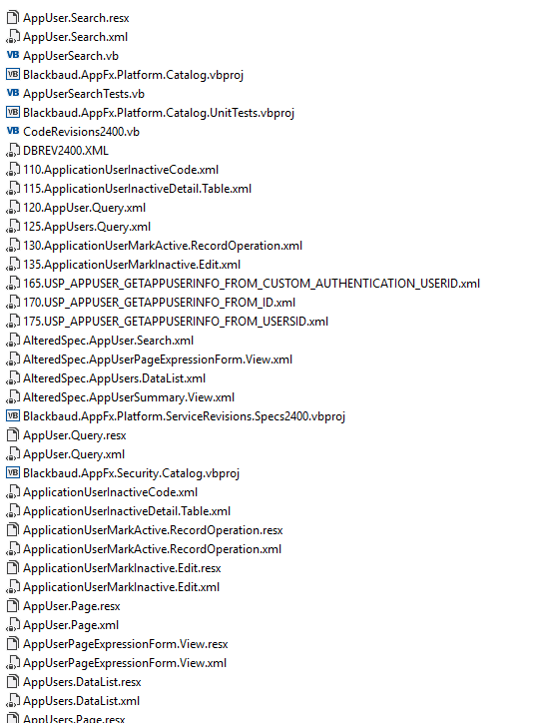
RoBUST, USABLE IMPLEMENTATION
Infinity Platform and CRM Application
7 different vb projects
Tables, Tasks, Search, Query, Data Warehouse, UI
Tests

Slide 5
Code Changes
2 files
>60 files
1 extra table column.
7 lines code authentication

Slide 6
Files in the slice
AppUsers.Page.xml
AppUsers.Query.xml
ApplicationUserMarkActive.RecordOperation.xml
ApplicationUserMarkInActive.Edit.xml

Slide 7
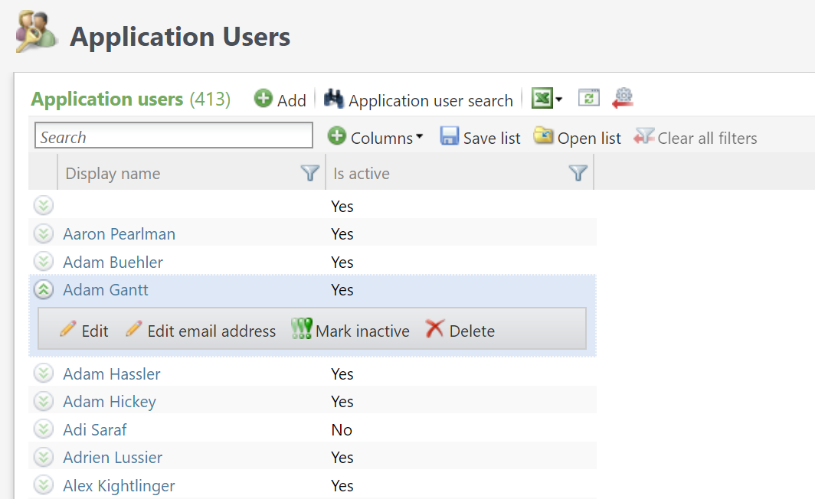

Slide 8
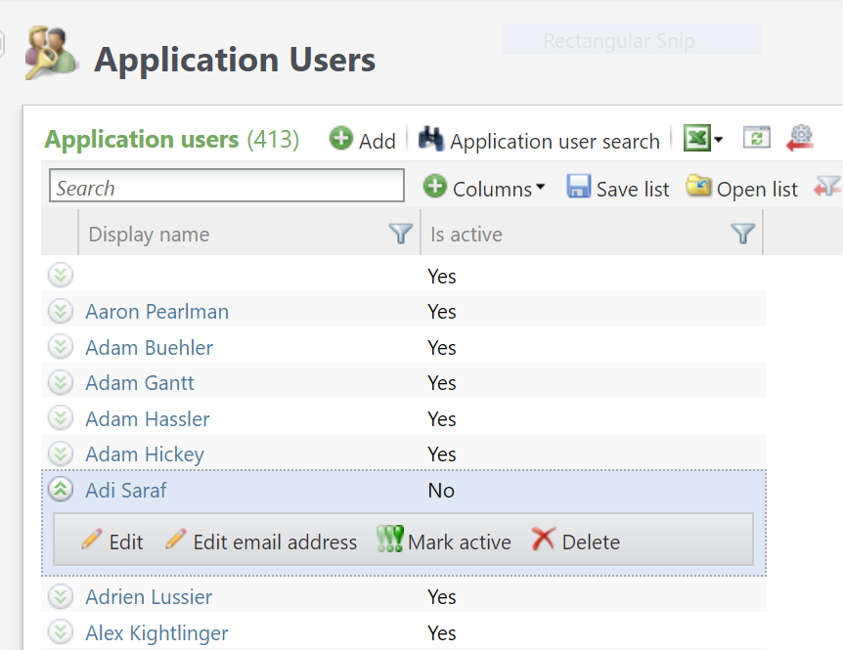

Slide 9
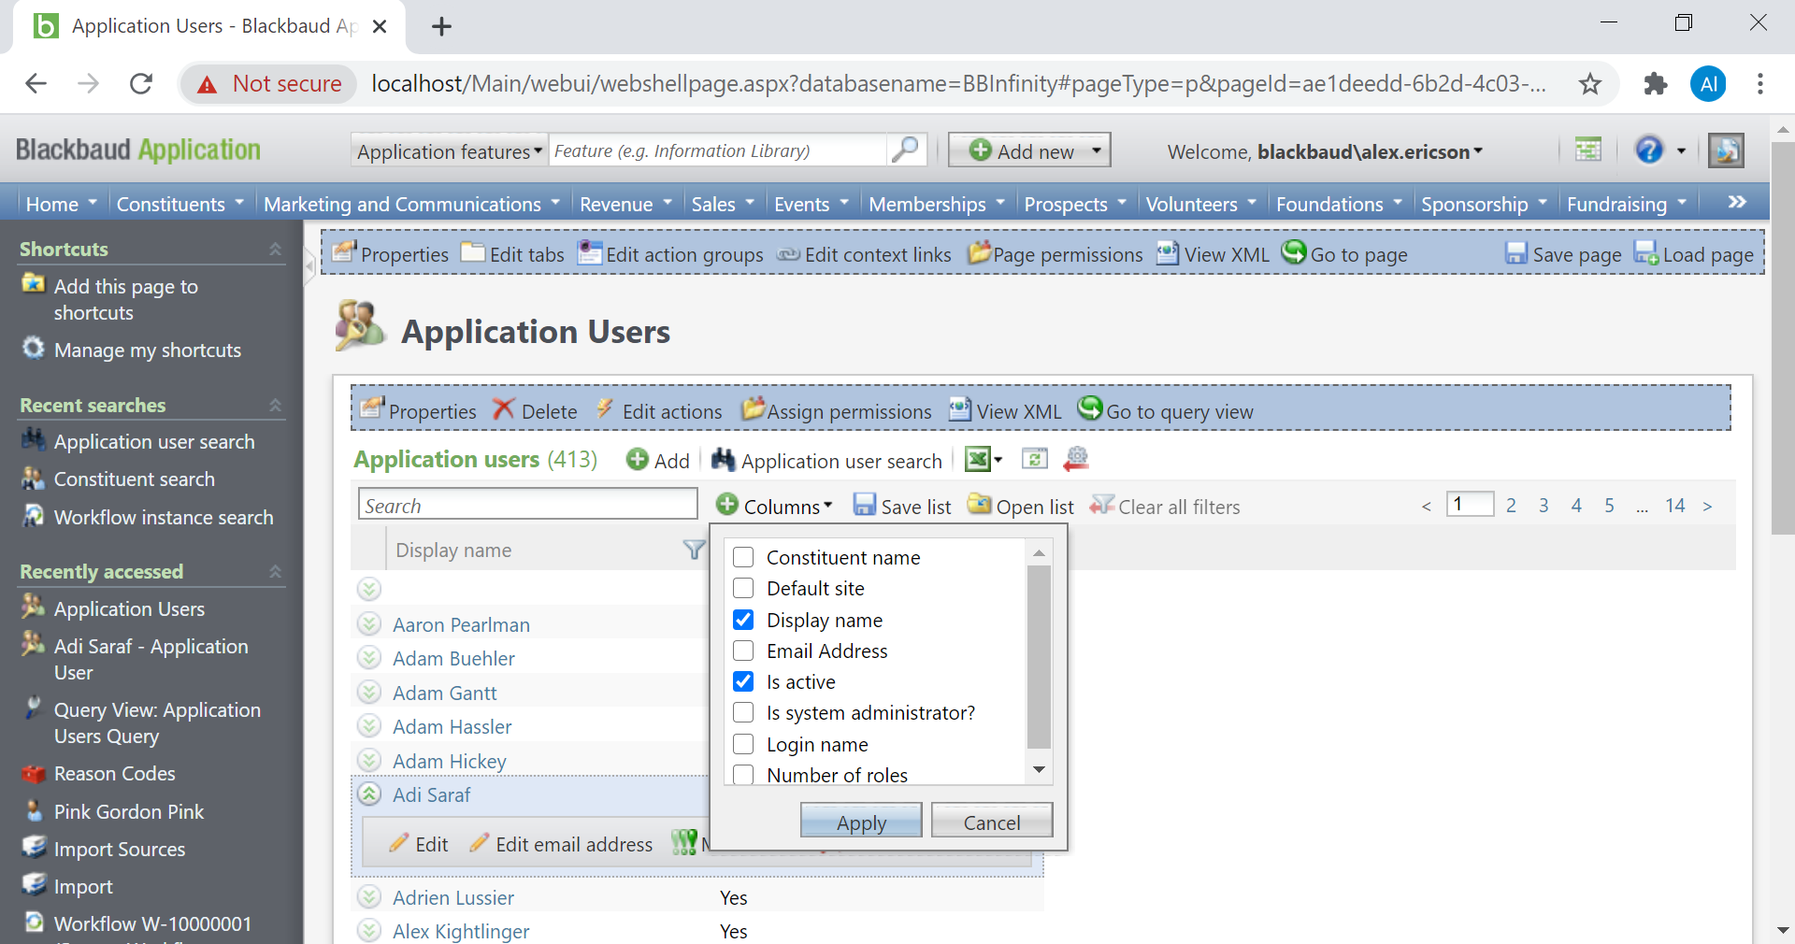

Slide 10
App Users Page
<PageHeader Caption="Application Users”. . . <Tabs>. . .<Sections>. . .
<ListBuilder QueryViewID="c2708523-974e-4956-b68f-6edec225b4c5">
<RequiredColumns>
<Column Name="ID" />
<Column Name="ISSYSTEM" />
<Column Name="DISPLAYNAME" />
<Column Name="CUSTOM_AUTHENTICATION_USERID" />
<Column Name="ISACTIVE" />
</RequiredColumns>
New ISACTIVE column available to view.

Slide 11
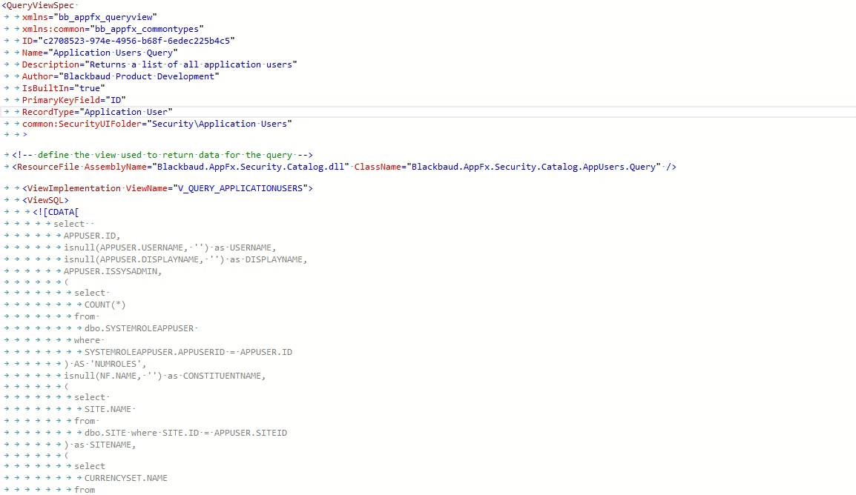
App Users Query xml
ID="c2708523-974e-4956-b68f-6edec225b4c5"
isnull(APPUSER.ISACTIVE,1) as ISACTIVE

Slide 13
App Users Page xml
<Action ID="bcf21e46-f4f6-4dfc-82e5-43092d34b02d"
Caption="Mark inactive"
Visible="=Not CBool(Fields!ISSYSTEM) AndAlso CBool(Fields!ISACTIVE) AndAlso (Products.ProductIsInstalled(InstalledProducts.Enterprise))"
ImageKey="RES:RecordOperationSpec" CaptionResourceKey="$$mark_inactive">
<c:ShowDataForm DataFormID="9d990ebd-8821-4d68-b30d-d14175842ef8">

Slide 15
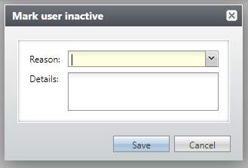

Slide 16
ApplicationUserMarkInactive.Edit
<EditDataFormTemplateSpec
xmlns="bb_appfx_editdataformtemplate"
xmlns:common="bb_appfx_commontypes"
ID="5235f7c0-e3c6-43a2-a2c4-3f6713f20c94"
Name="Application User Mark Inactive Edit Data Form"
Description="Marks an application user inactive and allows editing inactive reason. "
Author="Blackbaud Product Development"
DataFormInstanceID="9d990ebd-8821-4d68-b30d-d14175842ef8"
RecordType="Application User"
common:SecurityUIFolder="Security\Application Users"
FormHeader="Mark user inactive"

Slide 17
ApplicationUserMarkInactive.Edit
FormHeaderResourceKey="$$mark_user_inactive" > <ResourceFile
AssemblyName="Blackbaud.AppFx.Security.Catalog.dll"
ClassName="Blackbaud.AppFx.Security.Catalog.ApplicationUserMarkInactive.Edit" />
<SPDataForm>
<LoadImplementation SPName="USP_DATAFORMTEMPLATE_EDITLOAD_APPLICATIONUSERINACTIVE"> <common:CreateProcedureSQL> </common:CreateProcedureSQL> </LoadImplementation>
<SaveImplementation SPName="USP_DATAFORMTEMPLATE_EDIT_APPLICATIONUSERINACTIVE"> <common:CreateProcedureSQL> </common:CreateProcedureSQL> </SaveImplementation>
</SPDataForm>
<FormMetaData FixedDialog="true" xmlns="bb_appfx_commontypes">
<FormFields>

Slide 18
ApplicationUserMarkInactive.Edit
<LoadImplementation
create procedure dbo.USP_DATAFORMTEMPLATE_EDITLOAD_APPLICATIONUSERINACTIVE ( @ID uniqueidentifier, @DATALOADED bit = 0 output, @TSLONG bigint = 0 output, @APPUSERINACTIVEREASONCODEID uniqueidentifier = null output, @DETAILS nvarchar(300) = null output )
as set nocount on;
-- be sure to set these, in case the select returns no rows
set @DATALOADED = 0; set @TSLONG = 0;
select @DATALOADED = 1,
@TSLONG = APPUSER.TSLONG,
@APPUSERINACTIVEREASONCODEID =APPUSERINACTIVEDETAIL.APPUSERINACTIVEREASONCODEID,
@DETAILS = APPUSERINACTIVEDETAIL.DETAILS
from dbo.APPUSER

Slide 19
ApplicationUserMarkInactive.Edit
<SaveImplementation
create procedure dbo.USP_DATAFORMTEMPLATE_EDIT_APPLICATIONUSERINACTIVE ( @ID uniqueidentifier, @CHANGEAGENTID uniqueidentifier = null, @APPUSERINACTIVEREASONCODEID uniqueidentifier, @DETAILS nvarchar(300) )
as set nocount on;
if @CHANGEAGENTID is null exec dbo.USP_CHANGEAGENT_GETORCREATECHANGEAGENT @CHANGEAGENTID output;
declare @CURRENTDATE datetime; set @CURRENTDATE = getdate();
begin try update dbo.APPUSER set ISACTIVE = 0,
CHANGEDBYID = @CHANGEAGENTID, DATECHANGED = @CURRENTDATE where ID = @ID;
update dbo.APPUSERINACTIVEDETAIL set APPUSERINACTIVEREASONCODEID = @APPUSERINACTIVEREASONCODEID,
DETAILS = @DETAILS,
CHANGEDBYID = @CHANGEAGENTID, DATECHANGED = @CURRENTDATE where ID = @ID;
if @@ROWCOUNT = 0
insert into dbo.APPUSERINACTIVEDETAIL (ID, APPUSERINACTIVEREASONCODEID, DETAILS, ADDEDBYID, CHANGEDBYID, DATEADDED, DATECHANGED) values (@ID, @APPUSERINACTIVEREASONCODEID, @DETAILS, @CHANGEAGENTID, @CHANGEAGENTID, @CURRENTDATE, @CURRENTDATE);

Slide 21
App Users Page xml
<Action ID="1fb98879-85d6-4f01-9b9f-c38ae6519709"
Caption="Mark active"
Visible="=Not CBool(Fields!ISSYSTEM) AndAlso Not CBool(Fields!ISACTIVE) AndAlso (Products.ProductIsInstalled(InstalledProducts.Enterprise))"
ImageKey="RES:RecordOperationSpec" CaptionResourceKey="$$mark_active">
<c:ExecuteRecordOperation RecordOperationID="36c5ec01-2bcf-482f-8687-39d033074aef">

Slide 22
Record Operation
<RecordOperationSpec
xmlns="bb_appfx_recordoperation"
xmlns:common="bb_appfx_commontypes"
Author="Blackbaud Product Development"
Name="Application User: Mark Active"
Description="This record operation is used to mark an application user active."
OperationType="Update"
RecordType="Application User"
ID="36c5ec01-2bcf-482f-8687-39d033074aef“
common:SecurityUIFolder="Security\Application Users" >
<ResourceFile AssemblyName="Blackbaud.AppFx.Security.Catalog.dll“

Slide 23
ClassName="Blackbaud.AppFx.Security.Catalog.ApplicationUserMarkActive.RecordOperation" />
<SPRecord> <SPOperationImplementation SPName="USP_RECORDOPERATION_MARKAPPUSERACTIVE"> <common:CreateProcedureSQL>
<![CDATA[ create procedure dbo.USP_RECORDOPERATION_MARKAPPUSERACTIVE (
@ID uniqueidentifier,@CHANGEAGENTID uniqueidentifier = null )
as set nocount on;
if @CHANGEAGENTID is null
exec dbo.USP_CHANGEAGENT_GETORCREATECHANGEAGENT @CHANGEAGENTID output;
update dbo.APPUSER set ISACTIVE = 1,
CHANGEDBYID = @CHANGEAGENTID,
DATECHANGED = getdate()
where APPUSER.ID = @ID;
exec dbo.USP_APPUSERINACTIVEDETAIL_DELETEBYID_WITHCHANGEAGENTID @ID, @CHANGEAGENTID;

Slide 24
return 0;
]]> <
/common:CreateProcedureSQL> </SPOperationImplementation> </SPRecord>
<Prompt>
<StandardPrompt Text="Are you sure you want to reactivate this user?" TextResourceKey="$$are_you_sure_you_want_to_reactivate_this_user?" />
</Prompt>
</RecordOperationSpec>

Slide 25
Record Operation
Vs Data Form
May have a user prompt
Reactivates User
User can input details
Marks user as inactive

Slide 26
Files we discussed
AppUsers.Page
AppUsers.Query
ApplicationUserMarkActive.RecordOperation
ApplicationUserMarkInActive.Edit

